Slide 1
Identifying Tourists from Public Transport Commuters
Speaker: Jim-An Tsai
Advisor: Jia-ling Koh
Author: Mingqiang Xue #, Huayu Wu #, Wei Chen #, Wee Siong Ng #, Gin Howe Goh
#Institute for Infocomm Research, A*STAR, Singapore
Date: 2015/3/5
Source: KDD’14

Slide 2
Outline
Introduction
Method
Experiment
Conclusion

Slide 3
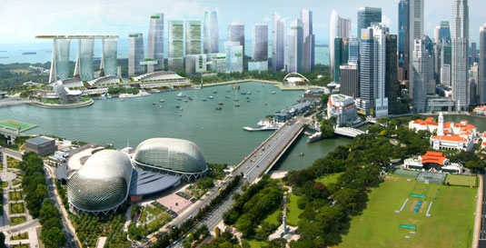
Introduction

Slide 4
Motivation
Why these researchers want to do this research?

Slide 5
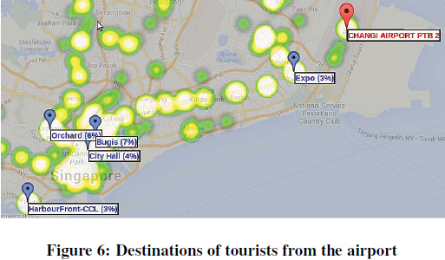
Purpose

Slide 6
Outline
Introduction
Method
Experiment
Conclusion

Slide 7
Problem Description
1. The Public Transport System and Dataset
2. Tourist Identification Problem

Slide 8
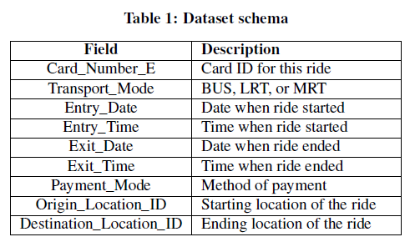
The Public Transport System and Dataset

Slide 9
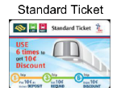
Tourist Identification Problem
Tourist
Local

Slide 10
Method
1. Station Ranking
2. Label Inference

Slide 11
Station Ranking

Slide 12
Station Ranking

Slide 13
Station Ranking

Slide 14
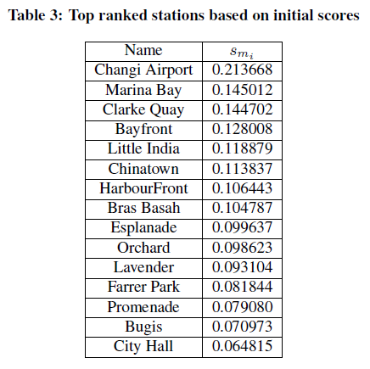
Station Ranking

Slide 15
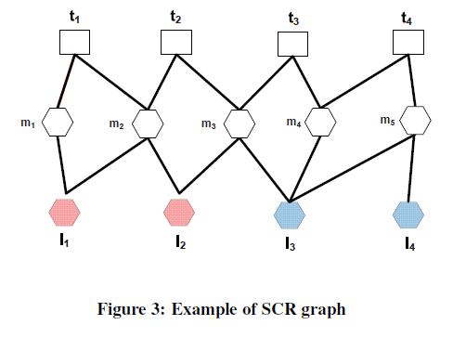
Label Inference
T
M
L

Slide 16
Label Inference

Slide 17
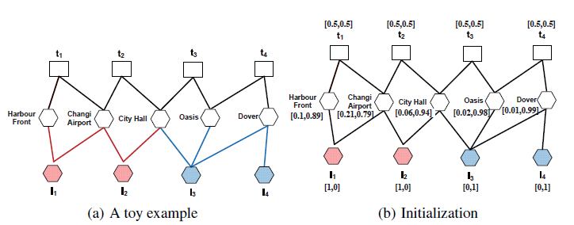
Label Inference

Slide 18
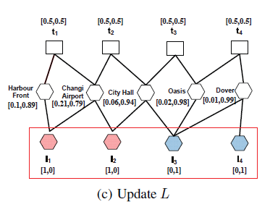
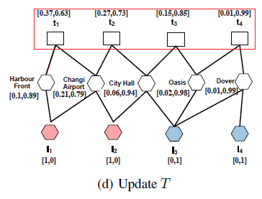
Label Inference

Slide 19
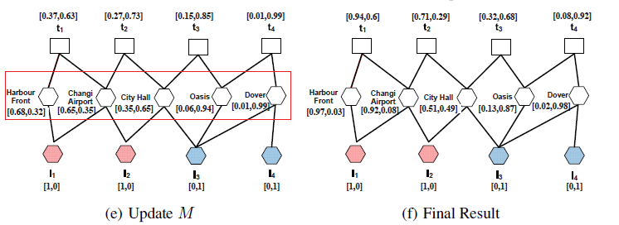
Label Inference

Slide 20
Label Inference
For example

Slide 21
Outline
Introduction
Method
Experiment
Conclusion

Slide 22
Experiment

Slide 23
Experiment

Slide 24
Outline
Introduction
Method
Experiment
Conclusion

Slide 25
Conclusion
1. Propose methodologies to discover tourists from public transport commuters.
2. Design an iterative learning algorithm to infer tourists from the whole population of public transport commuters.
3. Develop a web-based interactive system, based on the algorithm, for LTA and other partners from tourism industry in Singapore to use the discovery result to improve their services.

Slide 26
Thanks for Listening

